Slide 1
What is Clustering?
Also called unsupervised learning, sometimes called classification by statisticians and sorting by psychologists and segmentation by people in marketing
Organizing data into classes such that there is
  high intra-class similarity
  low inter-class similarity
Finding the class labels and the number of classes directly from the data (in contrast to classification).
More informally, finding natural groupings among objects.

Slide 2
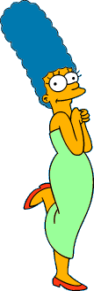



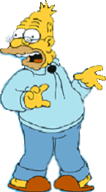
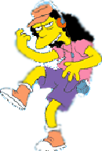
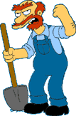

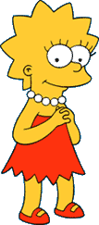
What is a natural grouping among these objects?

Slide 3
What is a natural grouping among these objects?
Clustering is subjective
Simpson's Family
School Employees
Females
Males

Slide 4
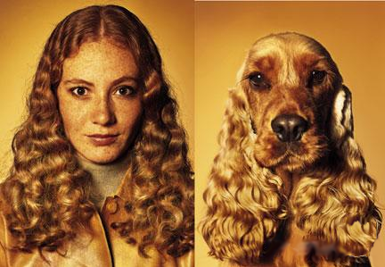
What is Similarity?
The quality or state of being similar; likeness; resemblance; as, a similarity of features.
Webster's Dictionary
Similarity is hard to define, but…
“We know it when we see it”
The real meaning of similarity is a philosophical question. We will take a more pragmatic approach.

Slide 5
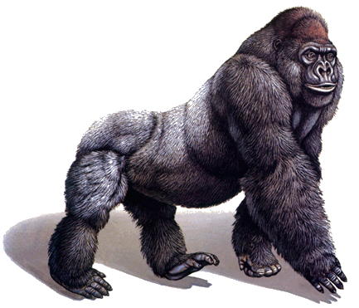
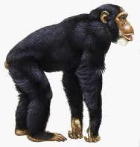
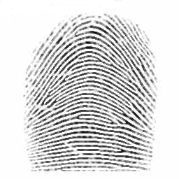
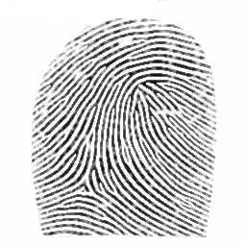
Defining Distance Measures
Definition: Let O₁ and O₂ be two objects from the universe of possible objects. The distance (dissimilarity) between O₁ and O₂ is a real number denoted by D(O₁,O₂)
Peter
Piotr
0.23
3
342.7

Slide 6
Peter
Piotr
When we peek inside one of these black boxes, we see some function on two variables. These functions might very simple or very complex.
In either case it is natural to ask, what properties should these functions have?
d('', '') = 0 d(s, '') = d('', s) = |s| -- i.e. length of s d(s1+ch1, s2+ch2) = min( d(s1, s2) + if ch1=ch2 then 0 else 1 fi, d(s1+ch1, s2) + 1, d(s1, s2+ch2) + 1 )
3
What properties should a distance measure have?
D(A,B) = D(B,A) Symmetry
D(A,A) = 0 Constancy of Self-Similarity
D(A,B) = 0 If A= B Positivity (Separation)
D(A,B) ≤ D(A,C) + D(B,C) Triangular Inequality

Slide 7
Intuitions behind desirable distance measure properties
D(A,B) = D(B,A) Symmetry
Otherwise you could claim “Alex looks like Bob, but Bob looks nothing like Alex.”
D(A,A) = 0 Constancy of Self-Similarity
Otherwise you could claim “Alex looks more like Bob, than Bob does.”
D(A,B) = 0 If A=B Positivity (Separation)
Otherwise there are objects in your world that are different, but you cannot tell apart.
D(A,B) ≤ D(A,C) + D(B,C) Triangular Inequality
Otherwise you could claim “Alex is very like Bob, and Alex is very like Carl, but Bob is very unlike Carl.”

Slide 8


Two Types of Clustering
Partitional algorithms: Construct various partitions and then evaluate them by some criterion (we will see an example called BIRCH)
Hierarchical algorithms: Create a hierarchical decomposition of the set of objects using some criterion
Hierarchical
Partitional

Slide 9
Desirable Properties of a Clustering Algorithm
Scalability (in terms of both time and space)
Ability to deal with different data types
Minimal requirements for domain knowledge to determine input parameters
Able to deal with noise and outliers
Insensitive to order of input records
Incorporation of user-specified constraints
Interpretability and usability

Slide 10
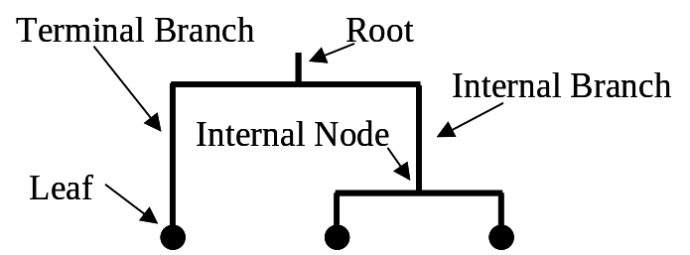
A Useful Tool for Summarizing Similarity Measurements
In order to better appreciate and evaluate the examples given in the early part of this talk, we will now introduce the dendrogram.
The similarity between two objects in a dendrogram is represented as the height of the lowest internal node they share.

Slide 11
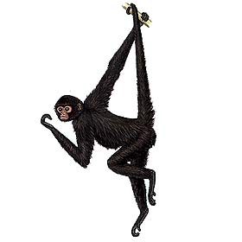
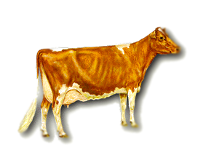
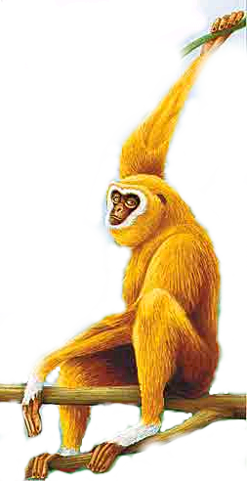
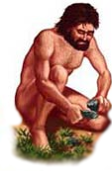
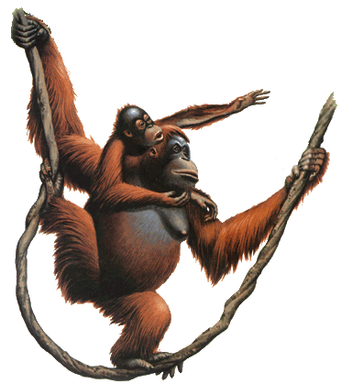
There is only one dataset that can be perfectly clustered using a hierarchy…
(Bovine:0.69395, (Spider Monkey 0.390, (Gibbon:0.36079,(Orang:0.33636,(Gorilla:0.17147,(Chimp:0.19268, Human:0.11927):0.08386):0.06124):0.15057):0.54939);

Slide 12

Note that hierarchies are commonly used to organize information, for example in a web portal.
Yahoo’s hierarchy is manually created, we will focus on automatic creation of hierarchies in data mining.
Business & Economy
B2B Finance Shopping Jobs
Aerospace Agriculture… Banking Bonds… Animals Apparel Career Workspace

Slide 13
A Demonstration of Hierarchical Clustering using String Edit Distance
Pedro (Portuguese)
Petros (Greek), Peter (English), Piotr (Polish), Peadar (Irish), Pierre (French), Peder (Danish), Peka (Hawaiian), Pietro (Italian), Piero (Italian Alternative), Petr (Czech), Pyotr (Russian)
Cristovao (Portuguese)
Christoph (German), Christophe (French), Cristobal (Spanish), Cristoforo (Italian), Kristoffer (Scandinavian), Krystof (Czech), Christopher (English)
Miguel (Portuguese)
Michalis (Greek), Michael (English), Mick (Irish!)
Piotr
Pedro
Piero
Peter
Peka
Mick
Pyotr
Pietro
Pierre
Peder
Petros
Peadar
Miguel
Krystof
Michael
Michalis
Crisdean
Cristovao
Christoph
Cristobal
Kristoffer
Christophe
Cristoforo
Christopher

Slide 14
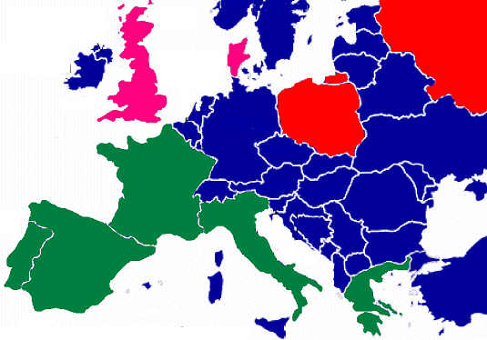
Pedro (Portuguese/Spanish)
Petros (Greek), Peter (English), Piotr (Polish), Peadar (Irish), Pierre (French), Peder (Danish), Peka (Hawaiian), Pietro (Italian), Piero (Italian Alternative), Petr (Czech), Pyotr (Russian)
Piotr
Pedro
Piero
Peter
Peka
Pyotr
Pietro
Pierre
Peder
Petros
Peadar

Slide 15











Hierarchal clustering can sometimes show patterns that are meaningless or spurious
For example, in this clustering, the tight grouping of Australia, Anguilla, St. Helena etc is meaningful, since all these countries are former UK colonies.
However the tight grouping of Niger and India is completely spurious, there is no connection between the two.
South Georgia &
South Sandwich
Islands
Serbia &
Montenegro
(Yugoslavia)
AUSTRALIA
St. Helena &
Dependencies
ANGUILLA
U.K.
FRANCE
NIGER
INDIA
IRELAND
BRAZIL

Slide 16
The flag of Niger is orange over white over green, with an orange disc on the central white stripe, symbolizing the sun. The orange stands the Sahara desert, which borders Niger to the north. Green stands for the grassy plains of the south and west and for the River Niger which sustains them. It also stands for fraternity and hope. White generally symbolizes purity and hope.
The Indian flag is a horizontal tricolor in equal proportion of deep saffron on the top, white in the middle and dark green at the bottom. In the center of the white band, there is a wheel in navy blue to indicate the Dharma Chakra, the wheel of law in the Sarnath Lion Capital. This center symbol or the 'CHAKRA' is a symbol dating back to 2nd century BC. The saffron stands for courage and sacrifice; the white, for purity and truth; the green for growth and auspiciousness.
South Georgia &
South Sandwich
Islands
Serbia &
Montenegro
(Yugoslavia)
AUSTRALIA
St. Helena &
Dependencies
ANGUILLA
U.K.
FRANCE
NIGER
INDIA
IRELAND
BRAZIL

Slide 17
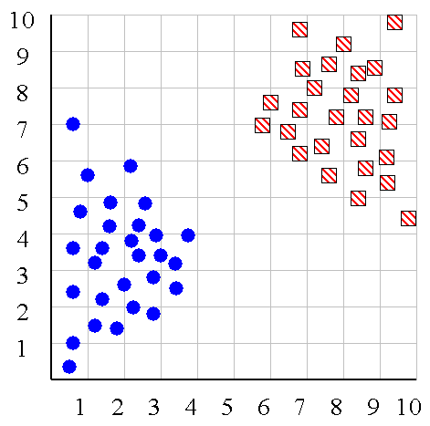
We can look at the dendrogram to determine the “correct” number of clusters. In this case, the two highly separated subtrees are highly suggestive of two clusters. (Things are rarely this clear cut, unfortunately)

Slide 18
One potential use of a dendrogram is to detect outliers
The single isolated branch is suggestive of a data point that is very different to all others
Outlier

Slide 19
(How-to) Hierarchical Clustering
The number of dendrograms with n leafs = (2n -3)!/[(2^{(n -2)}) (n -2)!]
Number Number of Possible
of Leafs Dendrograms
2 1
3 3
4 15
5 105
... …
34,459,425
Since we cannot test all possible trees we will have to heuristic search of all possible trees. We could do this..
Bottom-Up (agglomerative): Starting with each item in its own cluster, find the best pair to merge into a new cluster. Repeat until all clusters are fused together.
Top-Down (divisive): Starting with all the data in a single cluster, consider every possible way to divide the cluster into two. Choose the best division and recursively operate on both sides.

Slide 20


We begin with a distance matrix which contains the distances between every pair of objects in our database.
0
8
8
7
7
0
2
4
4
D( , ) = 8
D( , ) = 1
0
3
3
0
1
0

Slide 21
Bottom-Up (agglomerative): Starting with each item in its own cluster, find the best pair to merge into a new cluster. Repeat until all clusters are fused together.
Consider all possible merges…
Choose the best
…

Slide 22
Bottom-Up (agglomerative): Starting with each item in its own cluster, find the best pair to merge into a new cluster. Repeat until all clusters are fused together.
Consider all possible merges…
Choose the best
…
Consider all possible merges…
Choose the best
…

Slide 23
Bottom-Up (agglomerative): Starting with each item in its own cluster, find the best pair to merge into a new cluster. Repeat until all clusters are fused together.
Consider all possible merges…
Choose the best
…
Consider all possible merges…
Choose the best
…
Consider all possible merges…
Choose the best
…

Slide 24
Bottom-Up (agglomerative): Starting with each item in its own cluster, find the best pair to merge into a new cluster. Repeat until all clusters are fused together.
Consider all possible merges…
Choose the best
…
Consider all possible merges…
Choose the best
…
Consider all possible merges…
Choose the best
…

Slide 25
We know how to measure the distance between two objects, but defining the distance between an object and a cluster, or defining the distance between two clusters is non obvious.
Single linkage (nearest neighbor): In this method the distance between two clusters is determined by the distance of the two closest objects (nearest neighbors) in the different clusters.
Complete linkage (furthest neighbor): In this method, the distances between clusters are determined by the greatest distance between any two objects in the different clusters (i.e., by the "furthest neighbors").
Group average linkage: In this method, the distance between two clusters is calculated as the average distance between all pairs of objects in the two different clusters.
Wards Linkage: In this method, we try to minimize the variance of the merged clusters

Slide 26
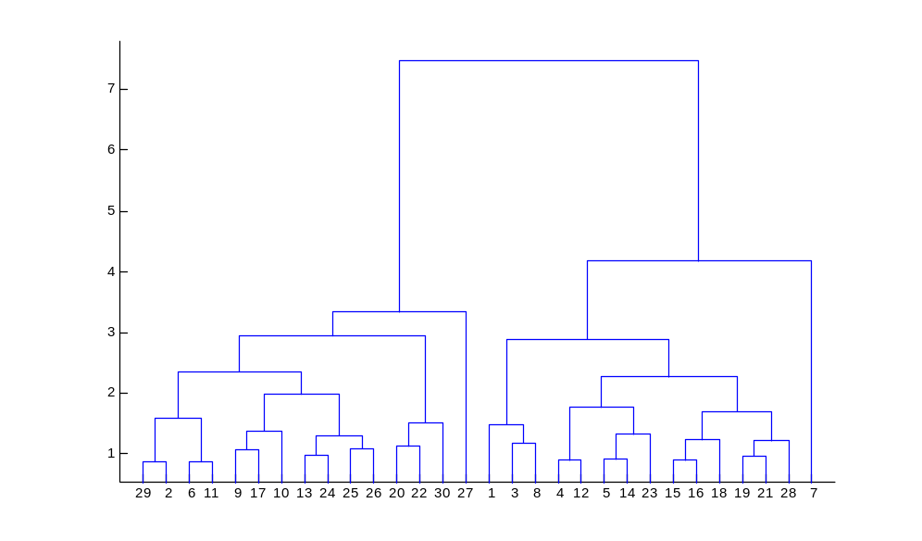
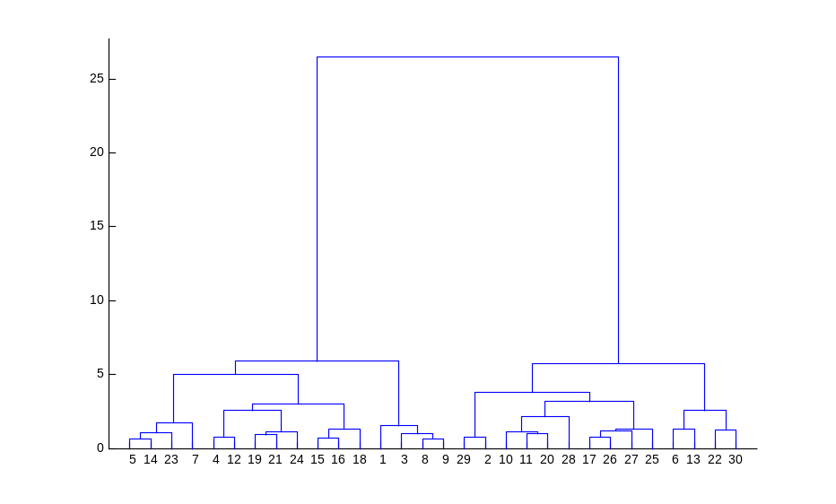
Single linkage
Average linkage
Wards linkage

Slide 27
Summary of Hierarchal Clustering Methods
No need to specify the number of clusters in advance.
Hierarchal nature maps nicely onto human intuition for some domains
They do not scale well: time complexity of at least O(n²), where n is the number of total objects.
Like any heuristic search algorithms, local optima are a problem.
Interpretation of results is (very) subjective.

Slide 28
Up to this point we have simply assumed that we can measure similarity, but
How do we measure similarity?
Peter
Piotr
0.23
3
342.7

Slide 29
A generic technique for measuring similarity
To measure the similarity between two objects, transform one of the objects into the other, and measure how much effort it took. The measure of effort becomes the distance measure.
The distance between Patty and Selma.
Change dress color, 1 point
Change earring shape, 1 point
Change hair part, 1 point
D(Patty,Selma) = 3
The distance between Marge and Selma.
Change dress color, 1 point
Add earrings, 1 point
Decrease height, 1 point
Take up smoking, 1 point
Lose weight, 1 point
D(Marge,Selma) = 5
This is called the “edit distance” or the “transformation distance”

Slide 30
Edit Distance Example
How similar are the names “Peter” and “Piotr”?
Assume the following cost function
Substitution 1 Unit
Insertion 1 Unit
Deletion 1 Unit
D(Peter,Piotr) is 3
It is possible to transform any string Q into string C, using only Substitution, Insertion and Deletion.
Assume that each of these operators has a cost associated with it.
The similarity between two strings can be defined as the cost of the cheapest transformation from Q to C.
Note that for now we have ignored the issue of how we can find this cheapest transformation
Peter
Piter
Pioter
Piotr
Substitution (i for e)
Insertion (o)
Piotr
Pedro
Piero
Peter
Deletion (e)
Pyotr
Petros
Pietro
Pierre

Slide 31
Partitional Clustering
Nonhierarchical, each instance is placed in exactly one of K nonoverlapping clusters.
Since only one set of clusters is output, the user normally has to input the desired number of clusters K.

Slide 32
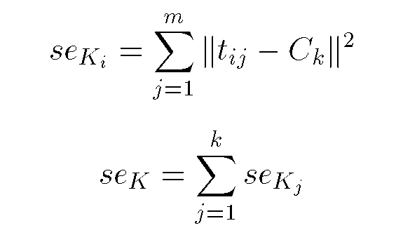
Squared Error
10
9
8
7
6
5
4
3
2
1
1
2
3
4
5
6
7
8
9
10
Objective Function

Slide 33
Algorithm k-means
1. Decide on a value for k.
2. Initialize the k cluster centers (randomly, if necessary).
3. Decide the class memberships of the N objects by assigning them to the nearest cluster center.
4. Re-estimate the k cluster centers, by assuming the memberships found above are correct.
5. If none of the N objects changed membership in the last iteration, exit. Otherwise goto 3.

Slide 34
K-means Clustering: Step 1
Algorithm: k-means, Distance Metric: Euclidean Distance
5
4
k₁
3
k₂
2
1
k₃
0
0
1
2
3
4
5

Slide 35
K-means Clustering: Step 2
Algorithm: k-means, Distance Metric: Euclidean Distance
5
4
k₁
3
k₂
2
1
k₃
0
0
1
2
3
4
5

Slide 36
K-means Clustering: Step 3
Algorithm: k-means, Distance Metric: Euclidean Distance
5
4
k₁
3
2
k₃
k₂
1
0
0
1
2
3
4
5

Slide 37
K-means Clustering: Step 4
Algorithm: k-means, Distance Metric: Euclidean Distance
5
4
k₁
3
2
k₃
k₂
1
0
0
1
2
3
4
5

Slide 38
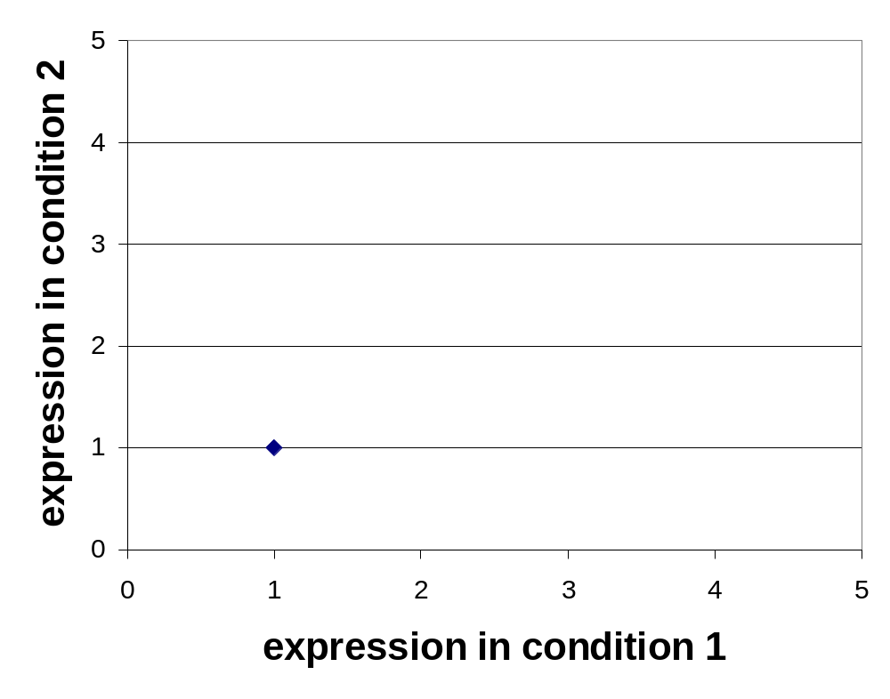
K-means Clustering: Step 5
Algorithm: k-means, Distance Metric: Euclidean Distance
k₁
k₂
k₃

Slide 39
Comments on the K-Means Method
Strength
  Relatively efficient: O(tkn), where n is # objects, k is # clusters, and t is # iterations. Normally, k, t << n.
  Often terminates at a local optimum. The global optimum may be found using techniques such as: deterministic annealing and genetic algorithms
Weakness
  Applicable only when mean is defined, then what about categorical data?
  Need to specify k, the number of clusters, in advance
  Unable to handle noisy data and outliers
  Not suitable to discover clusters with non-convex shapes

Slide 40
The K-Medoids Clustering Method
Find representative objects, called medoids, in clusters
PAM (Partitioning Around Medoids, 1987)
  starts from an initial set of medoids and iteratively replaces one of the medoids by one of the non-medoids if it improves the total distance of the resulting clustering
  PAM works effectively for small data sets, but does not scale well for large data sets

Slide 41
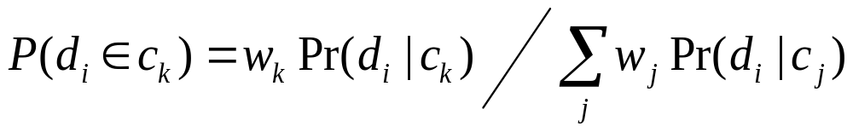
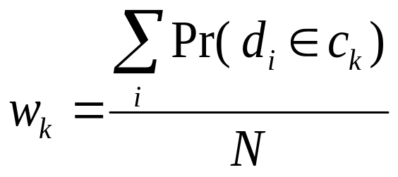
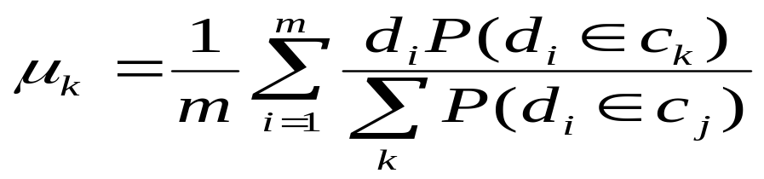
EM Algorithm
Initialize K cluster centers
Iterate between two steps
  Expectation step: assign points to clusters
  Maximation step: estimate model parameters

Slide 44
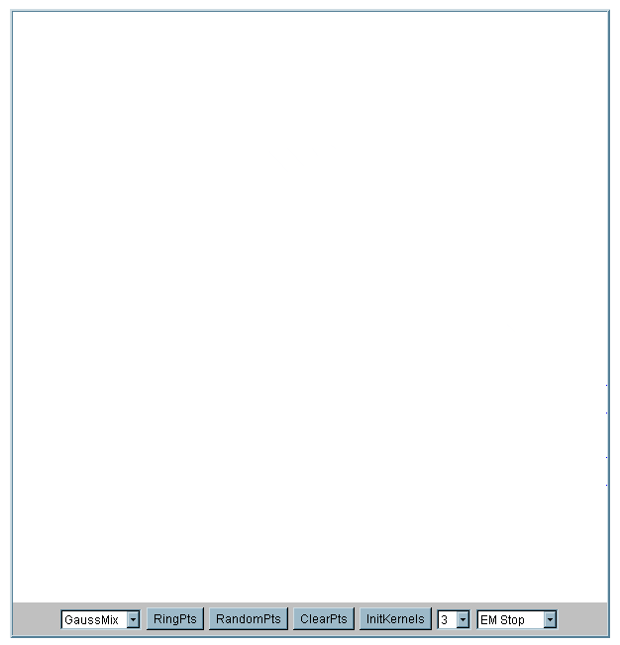
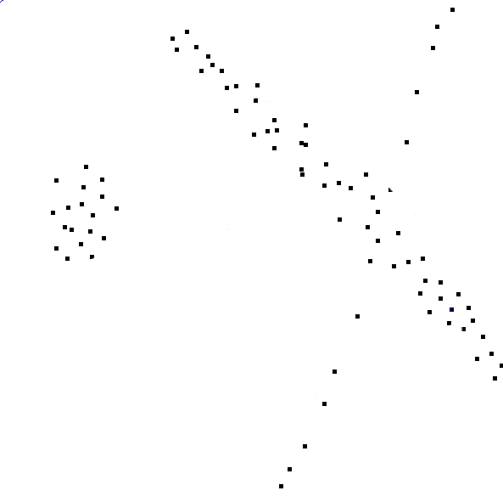

Slide 45
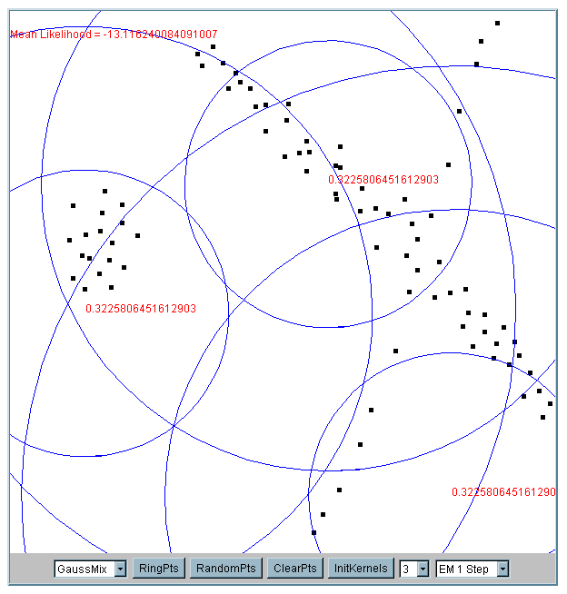
Iteration 1
The cluster means are randomly assigned

Slide 46
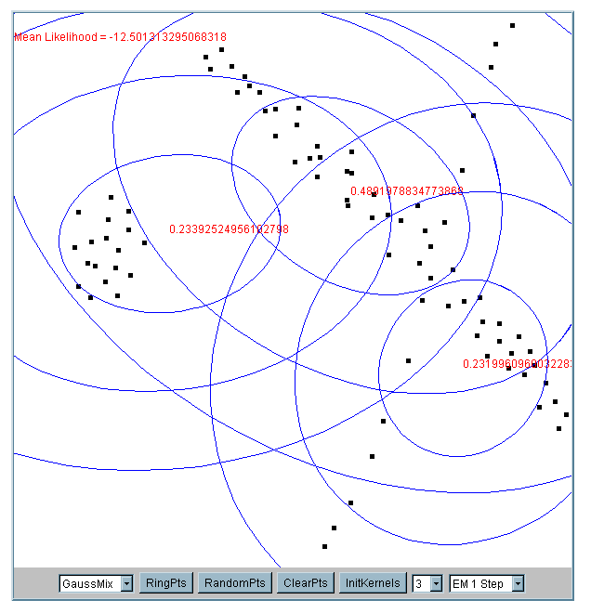
Iteration 2

Slide 47
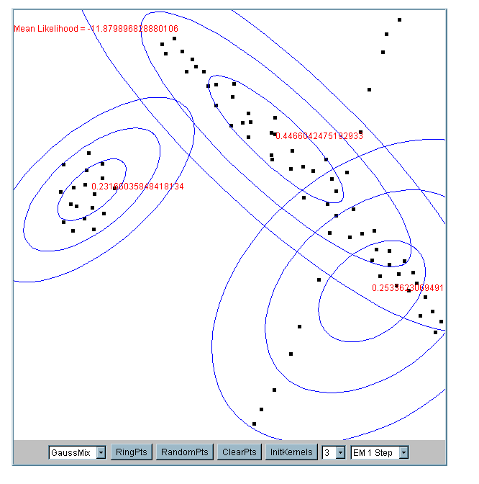
Iteration 5

Slide 48
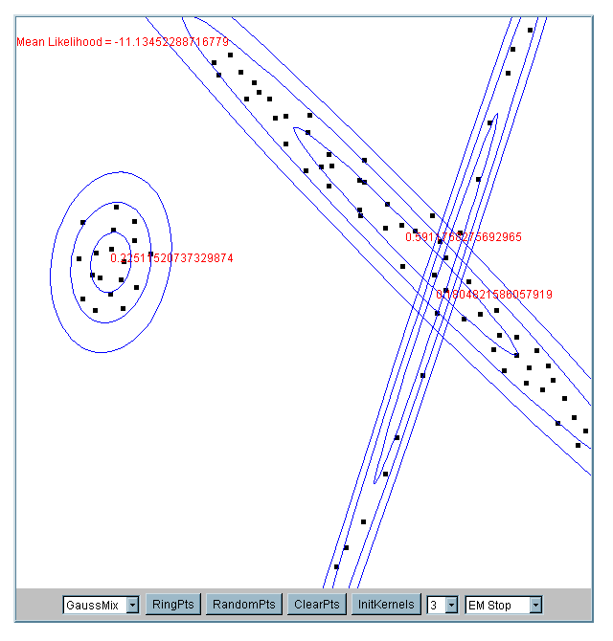
Iteration 25

Slide 49
What happens if the data is streaming…
Nearest Neighbor Clustering
Not to be confused with Nearest Neighbor Classification
Items are iteratively merged into the existing clusters that are closest.
Incremental
Threshold, t, used to determine if items are added to existing clusters or a new cluster is created.

Slide 50
10
9
8
7
Threshold t
6
5
4
3
1
t
2
1
2
1
2
3
4
5
6
7
8
9
10

Slide 51
10
9
8
7
6
New data point arrives…
It is within the threshold for cluster 1, so add it to the cluster, and update cluster center.
5
4
3
1
3
2
1
2
1
2
3
4
5
6
7
8
9
10

Slide 52
New data point arrives…
It is not within the threshold for cluster 1, so create a new cluster, and so on..
10
4
9
8
7
6
5
4
3
1
3
2
1
2
Algorithm is highly order dependent…
It is difficult to determine t in advance…
1
2
3
4
5
6
7
8
9
10

Slide 53
Partitional Clustering Algorithms
Clustering algorithms have been designed to handle very large datasets
E.g. the Birch algorithm
  Main idea: use an in-memory R-tree to store points that are being clustered
  Insert points one at a time into the R-tree, merging a new point with an existing cluster if is less than some δ distance away
  If there are more leaf nodes than fit in memory, merge existing clusters that are close to each other
  At the end of first pass we get a large number of clusters at the leaves of the R-tree
    Merge clusters to reduce the number of clusters

Slide 54
Partitional Clustering Algorithms
We need to specify the number of clusters in advance, I have chosen 2
The Birch algorithm
R10
R11
R10 R11 R12
R1 R2 R3
R4 R5 R6
R7 R8 R9
R12
Data nodes containing points

Slide 55
Partitional Clustering Algorithms
The Birch algorithm
R10
R11
R10 R11 R12
{R1,R2} R3
R4 R5 R6
R7 R8 R9
R12
Data nodes containing points

Slide 56
Partitional Clustering Algorithms
The Birch algorithm
R10
R11
R12

Slide 57
How can we tell the right number of clusters?
In general, this is a unsolved problem. However there are many approximate methods. In the next few slides we will see an example.
10
9
For our example, we will use the familiar katydid/grasshopper dataset.
However, in this case we are imagining that we do NOT know the class labels. We are only clustering on the X and Y axis values.
8
7
6
5
4
3
2
1
1
2
3
4
5
6
7
8
9
10

Slide 58
When k = 1, the objective function is 873.0
1
2
3
4
5
6
7
8
9
10

Slide 59
When k = 2, the objective function is 173.1
1
2
3
4
5
6
7
8
9
10

Slide 60
When k = 3, the objective function is 133.6
1
2
3
4
5
6
7
8
9
10

Slide 61
We can plot the objective function values for k equals 1 to 6…
The abrupt change at k = 2, is highly suggestive of two clusters in the data. This technique for determining the number of clusters is known as “knee finding” or “elbow finding”.
1.00E+03
9.00E+02
8.00E+02
7.00E+02
6.00E+02
Objective Function
5.00E+02
4.00E+02
3.00E+02
2.00E+02
1.00E+02
0.00E+00
k
1
2
3
4
5
6
Note that the results are not always as clear cut as in this toy example

